Slide 1
Data Models

Slide 2
A data model in software engineering is an abstract model that describes how data are represented and accessed.
Data models are expressed in terms of entities, attributes, domains, and relationships.
Typical applications of data models include database models and design of information systems.
A data model can be sometimes referred to as a data structure, especially in the context of programming languages

Slide 3
Models an enterprise as a collection of entities and relationships
Entity: a “thing” or “object” in the enterprise that is distinguishable from other objects
Described by a set of attributes
Relationship: an association among several entities
Represented diagrammatically by an entity-relationship diagram

Slide 4
Data model theory
A data model theory has three main components:
The structural part: a collection of data structures which are used to create databases representing the entities or objects modelled by the database.
The integrity part: a collection of rules governing the constraints placed on these data structures to ensure structural integrity.
The manipulation part: a collection of operators which can be applied to the data structures, to update and query the data contained in the database.

Slide 5
Data Modelling
Data modelling answers a set of specific questions that are relevant to any data processing application.
What are the primary data objects to be processed by the system?
What is the composition of each data object and what attributes describe the object?
Where do the objects currently reside?
What are the relationships between each object and other objects?
What are the relationships between the objects and the processes that transform them?

Slide 6
To answer these questions, data modelling methods make use of the entity relationship diagram.
The ERD enables a software engineer to identify data objects and their relationships using a graphical notation.
In the context of structured analysis, the ERD defines all data that are entered, stored, transformed, and produced within an application.
The entity relationship diagram focuses solely on data that exists for a given system.
The ERD is especially useful for applications in which data and the relationships that govern the data are complex.

Slide 7
ER - Entity-Relationship
In ER diagram, entities are represented as rectangles, attributes as ellipses and relationships between entities as diamonds.
Entities
An entity is anything about which the system needs to store information.
Nouns and verbs are always candidate entities.
"Customers buy products. Employees sell products. Suppliers sell us products.
" The nouns "Customers," "Products," "Employees," and "Suppliers" are all clearly entities.

Slide 8
Attributes
A system has to keep track of certain facts about each entity. These facts are the entity's attributes.
If a system includes a Customer entity, then the names, addresses, and businesses they're in should be known.
Domains
It is the set of all possible values that an attribute may validly contain.
For example, "StreetName" and "Surname" might both be represented as text fields, but they are obviously different kinds of text fields; they belong to different domains.

Slide 9
Relationships
In addition to the attributes of each entity, a data model must specify the relationships between entities.
At the conceptual level, relationships are simply associations between entities.
The statement "Customers buy products" indicates that a relationship exists between the entities Customers and Products.
The entities involved in a relationship are called its participants.
The number of participants is the degree of the relationship.

Slide 10
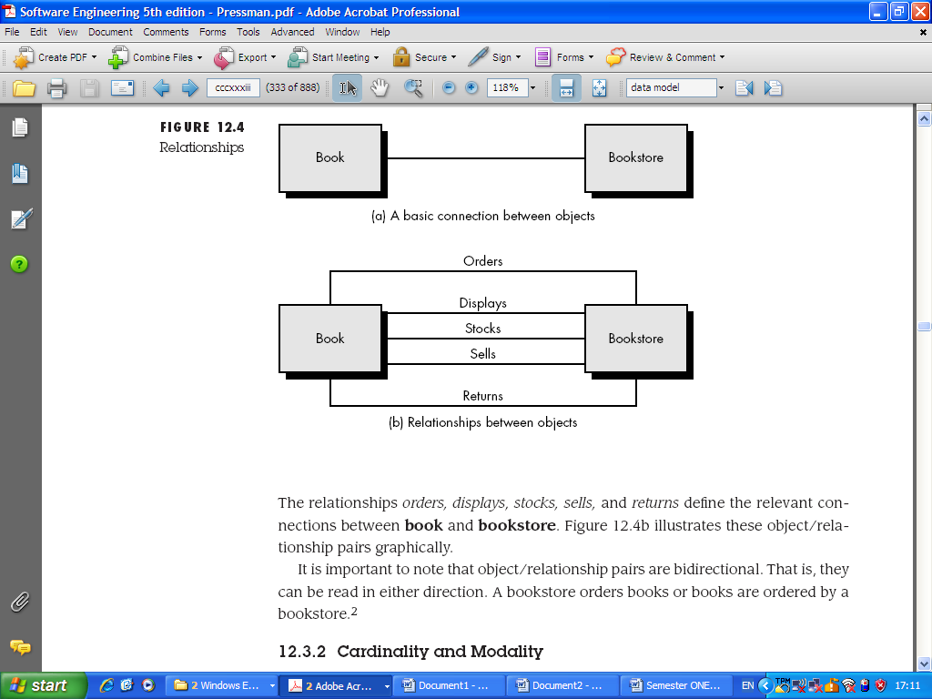
The vast majority of relationships are binary, like the "Customers buy products“
Ternary relationships, those with three participants, are also common.
Given the binary relationships "Employees sell products" and "Customers buy products," there is an implicit ternary relationship "Employees sell products to customers."

Slide 12
Cardinality and Modality
The elements of data modelling: data objects, attributes, and relationships provide the basis for understanding the information domain of a problem.
However, additional information related to these basic elements must also be understood.
For instance, a simple pair that states: object X relates to object Y does not provide enough information for software engineering purposes.
We must understand how many occurrences of object X are related to how many occurrences of object Y. This leads to a data modelling concept called cardinality.

Slide 13
Cardinality: The data model must be capable of representing the number of occurrences objects in a given relationship.
Cardinality is the specification of the number of occurrences of one [object] that can be related to the number of occurrences of another [object].
Cardinality is usually expressed as simply 'one' or 'many.'
For example, a husband can have only one wife (in most cultures), while a parent can have many children.
One-to-one (l:l): An occurrence of [object] 'A' can relate to one and only one occurrence of [object] 'B,' and an occurrence of 'B' can relate to only one occurrence of 'A.'

Slide 14
One-to-many (l:N)—One occurrence of [object] 'A' can relate to one or many occurrences of [object] 'B,' but an occurrence of 'B' can relate to only one occurrence of 'A.'
For example, a mother can have many children, but a child can have only one mother.
Many-to-many (M:N)—An occurrence of [object] 'A' can relate to one or more occurrences of 'B,' while an occurrence of 'B' can relate to one or more occurrences of 'A.'
For example, an uncle can have many nephews, while a nephew can have many uncles.

Slide 15
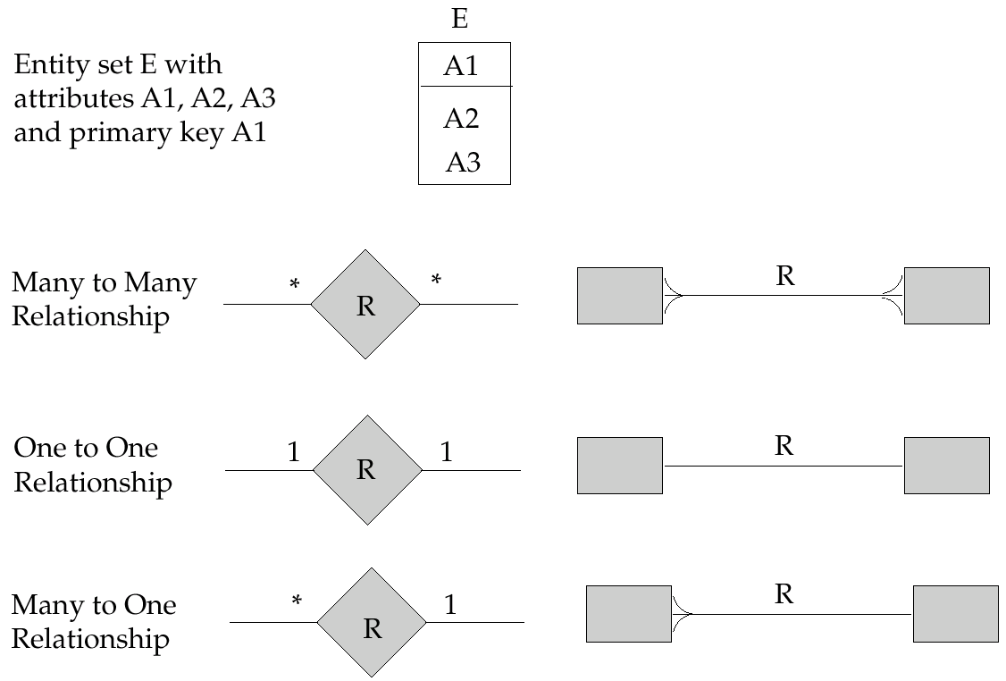

Slide 16
Modality: The modality of a relationship is 0 if there is no explicit need for the relationship to occur or the relationship is optional. The modality is 1 if an occurrence of the relationship is mandatory.
To illustrate, consider software that is used by a local telephone company to process requests for field service.
A customer indicates that there is a problem.
If the problem is diagnosed as relatively simple, a single repair action occurs.
However, if the problem is complex, multiple repair actions may be required.

Slide 17
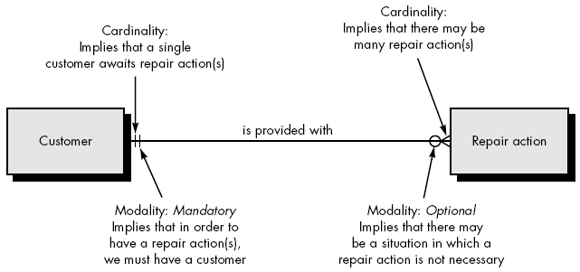
The figure below illustrates the relationship, cardinality, and modality between the data objects customer and repair action.

Slide 18
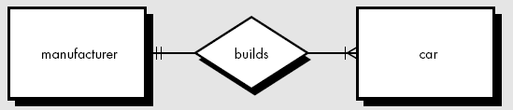
The relationship between the data objects car and manufacturer says one manufacturer builds one or many cars.

Slide 19
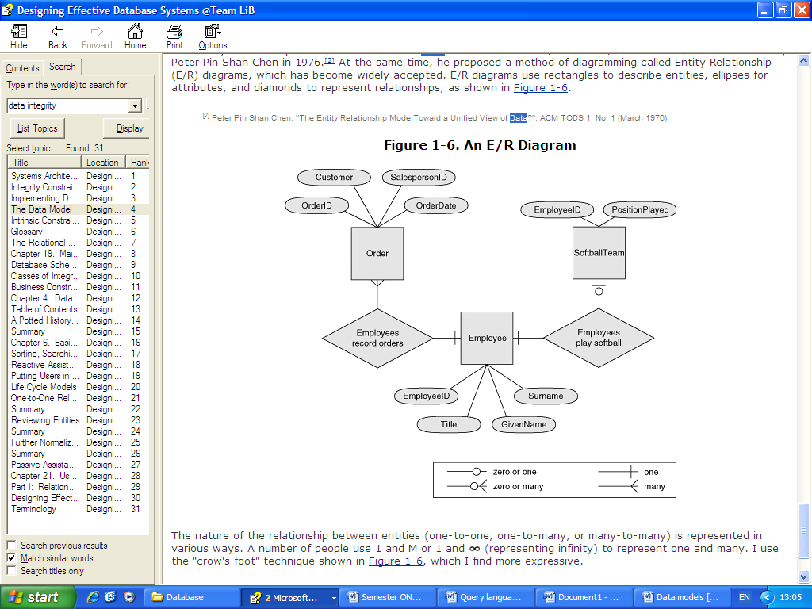
Entity Relationship Diagrams

Slide 20
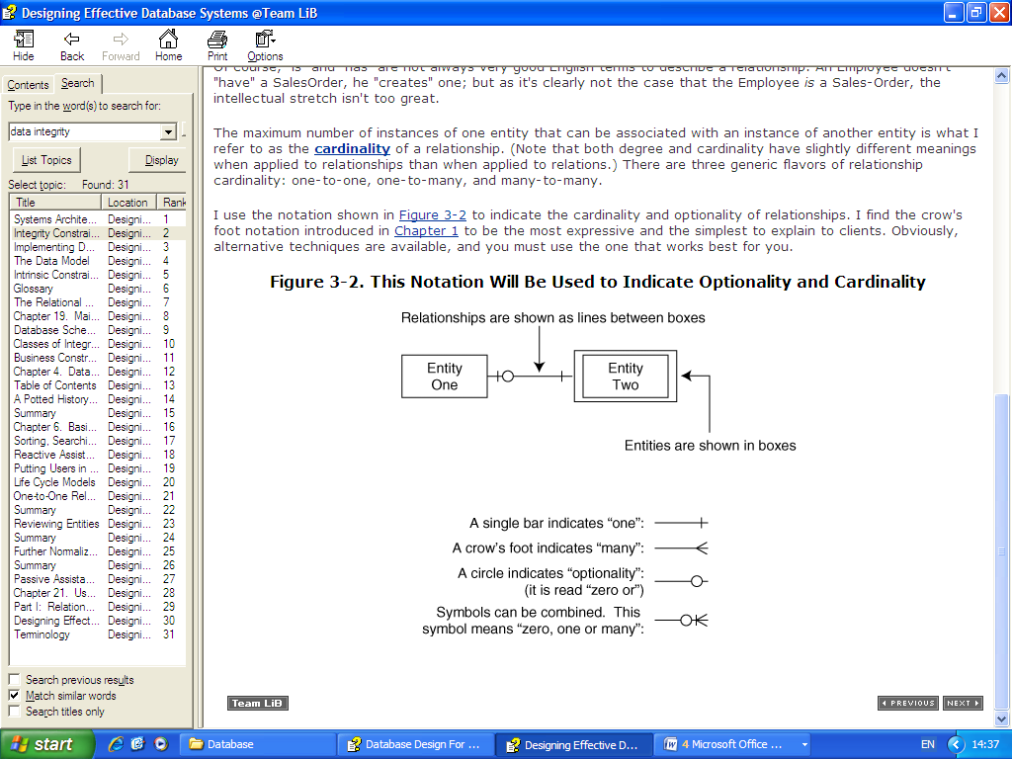
The nature of the relationship between entities (one-to-one, one-to-many, or many-to-many) is represented in various ways.
A number of people use 1 and M or 1 and ∞ (representing infinity) to represent one and many.

Slide 21
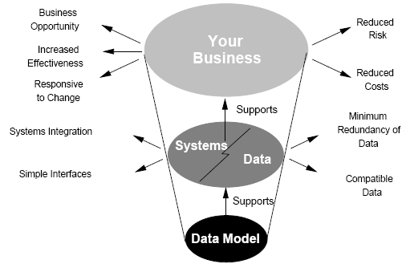
The role of data models

Slide 22
How data models deliver benefit.
The main aim of data models is to support the development of information systems by providing the definition and format of data.
If this is done consistently across systems then compatibility of data can be achieved.
If the same data structures are used to store and access data then different applications can share data.
However, systems and interfaces often cost more than they should, to build, operate, and maintain.

Slide 23
They may also constrain the business rather than support it.
A major cause is that the quality of the data models implemented in systems and interfaces is poor.

Slide 24
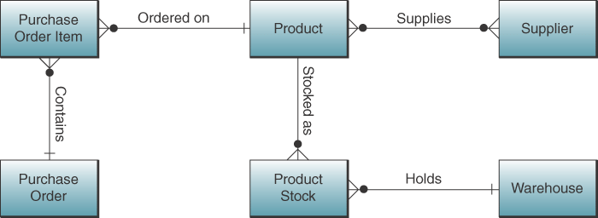

Slide 26
A relational database is to be designed for a medium sized Company dealing with industrial applications of computers. The Company delivers various products to its customers ranging from a single application program through to complete installation of hardware with customized software. The Company employs various experts, consultants and supporting staff. All personnel are employed on long-term basis, i.e. there are no short-term or temporary staff.
Although the Company is somehow structured for administrative purposes (that is, it is divided into departments headed by department managers) all projects are carried out in an inter-disciplinary way. For each project a project team is selected, grouping employees from different departments, and a Project Manager (also an employee of the Company) is appointed who is entirely and exclusively responsible for the control of the project, quite independently of the Company’s hierarchy. The following is a brief statement of some facts and policies adopted by the Company.

